Slide 1
Comp 313
Design and Analysis of Algorithms
Lecture 2 DESIGN TECHNIQUES

Slide 2
Devotional Meditation
Ephesian 6:24
Grace to all who love our Lord Jesus Christ with an undying love.

Slide 3
Lecture Outline

Slide 4
Algorithm Design Techniques
Algorithm design is a specific method to create a mathematical process in solving problems. Applied algorithm design is algorithm engineering.
One of the most important aspects of algorithm design is creating an algorithm that is efficient. .

Slide 5
Techniques
Simple recursive algorithms • Backtracking algorithms • Divide and conquer algorithms • Dynamic programming algorithms • Greedy algorithms • Branch and bound algorithms • Brute force algorithms • Randomized algorithms

Slide 6
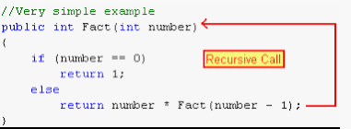
Simple recursive algorithms
.
A recursive algorithm is an algorithm which calls itself with "smaller (or simpler)" input values, and which obtains the result for the current input by applying simple operations to the returned value for the smaller (or simpler) input

Slide 7
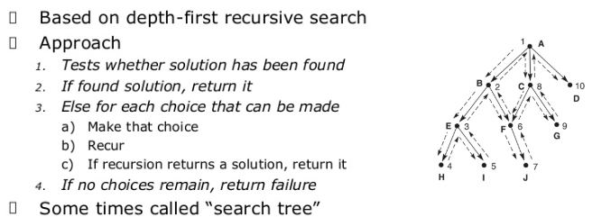
Backtracking
Backtracking Algorithm tries each possibility until they find the right one. It is a depth-first search of the set of possible solution. During the search, if an alternative doesn't work, then backtrack to the choice point, the place which presented different alternatives, and tries the next alternative.

Slide 8
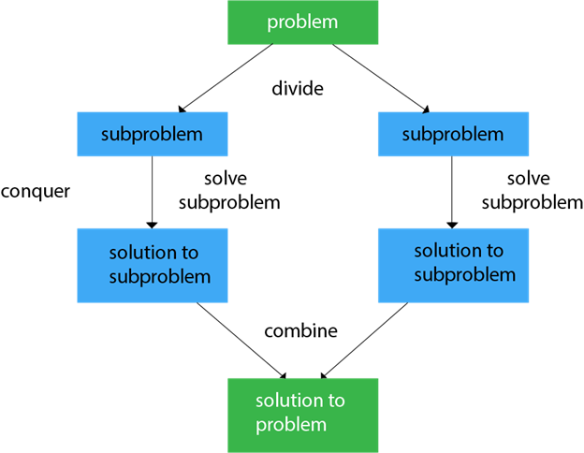
Divide and Conquer
It is a top-down approach. The algorithms which follow the divide & conquer techniques involve three steps:
Divide the original problem into a set of subproblems.
Solve every subproblem individually, recursively.
Combine the solution of the subproblems (top level) into a solution of the whole original problem

Slide 9
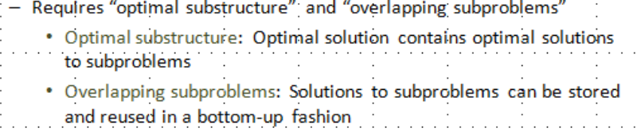
Dynamic programming algorithms
Dynamic Programming is a bottom-up approach we solve all possible small problems and then combine them to obtain solutions for bigger problems.
This is particularly helpful when the number of copying sub-problems is exponentially large. Dynamic Programming is frequently related to Optimization Problems e.g. Knapsack problem, Matrix chain multiplication , least common subsequence(LCS)

Slide 10
Greedy algorithms
Greedy method is used to solve the optimization problem. An optimization problem is one in which we are given a set of input values, which are required either to be maximized or minimized (known as objective), i.e. some constraints or conditions.
Greedy Algorithm always makes the choice (greedy criteria) looks best at the moment, to optimize a given objective e.g Shortest path algorithm , MSTs.
A greedy algorithm sometimes work well for optimization problems
A greedy algorithm works in phases, at each phase – take the best you can get right now and disregards any future consequences and hopes that by choosing a local optimum at each phase , you will end up at global optimum

Slide 11
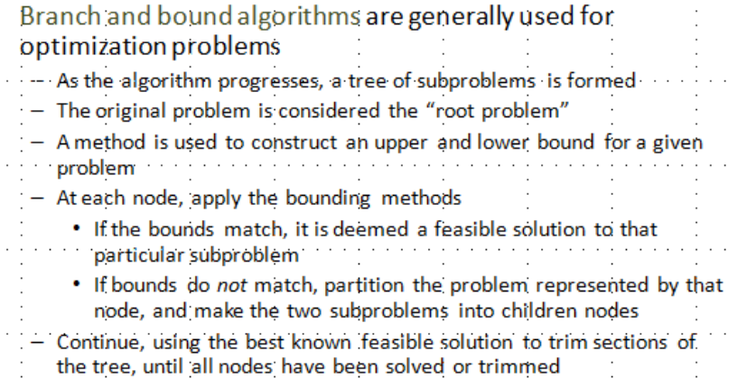
Branch and bound algorithms

Slide 12
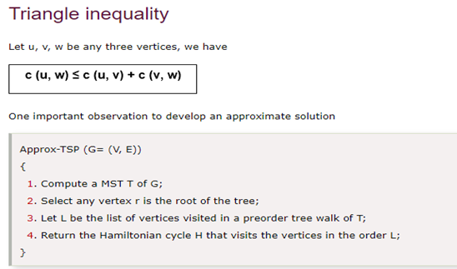
TSP problem
In the traveling salesman Problem, a salesman must visits n cities. visiting each city exactly once and finishing at the city he starts from (Hamiltonian cycle). It assumes the cost satisfies the triangle inequality.
Why is TSP an NP hard problem???

Slide 13
Brute force algorithms
A straightforward method of solving a problem that rely on sheer computing power and trying every possibility rather than advanced techniques to improve efficiency.
Brute force attacks which cracks a password that involves permutation.

Slide 14
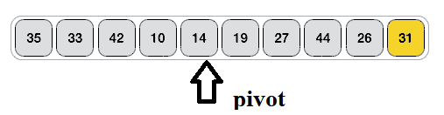
Randomized algorithms
A randomized algorithm is defined as an algorithm that is allowed to access a source of independent, unbiased random bits, and it is then allowed to use these random bits to influence its computation.
Applied in cryptography to generate random keys to secure systems.
Sorting e.g Quick sort

Slide 15
Algorithm analysis
Analysis of Algorithms is the area of computer science that provides tools to analyze the efficiency ( time and space ) of different methods of solutions.
Time Complexity: Running time of a program as a function of the size of the input.
Space Complexity: Some forms of analysis could be done based on how much space an algorithm needs to complete its task.

Slide 16
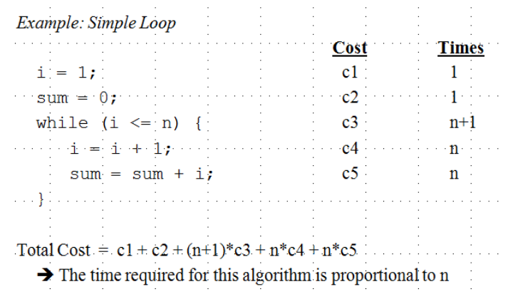
Execution time

Slide 17
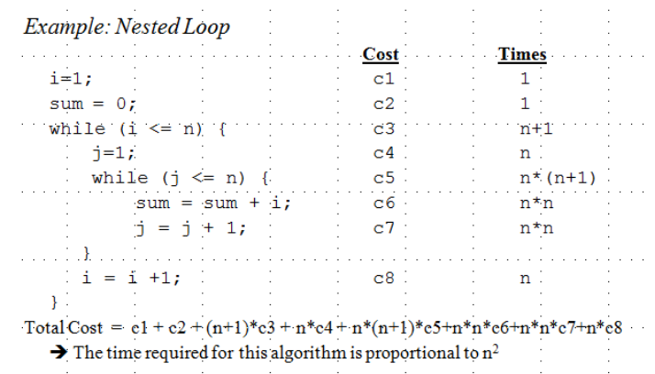

Slide 18
Types of analysis
Priori analysis- theoretical analysis (before implementation)
Posteriori analysis- ( After implementation)
Broadly, we can also achieve the following types of analysis -
Worst-case: f (n) defined by the maximum number of steps taken on any instance of size n
Best-case: f (n) defined by the minimum number of steps taken on any instance of size n.
Average case: f (n) defined by the average number of steps taken on any instance of size n.

Slide 19
Algorithm analysis techniques
Asymptotic Notations
Master theorem
Asymptotic analysis
In mathematical analysis, asymptotic analysis of an algorithm is a method of defining the mathematical boundation of its run-time performance. Using the asymptotic analysis, we can easily conclude about the average case, best case and worst case scenario of an algorithm.
It is used to mathematically calculate the running time of any operation inside an algorithm.

Slide 20
Example: Running time of one operation is F(n) and for another operation it is calculated as f(n2). It refers to running time will increase linearly with increase in 'n' for first operation and running time will increase exponentially for second operation. Similarly the running time of both operations will be same if n is significantly small.
Asymptotic Notations
The commonly used asymptotic notations for calculating the Complexity of an algorithm are:-
Big oh Notation (Ο)(worse case)- upper bounds
Omega Notation (Ω)(Best case)- Lower bound
Theta Notation (θ) (Average case)- (Tight Bound)

Slide 21
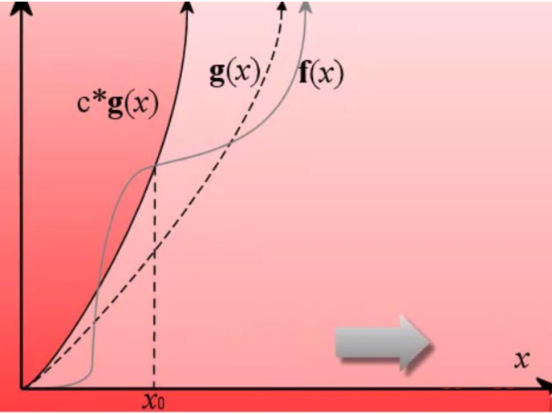
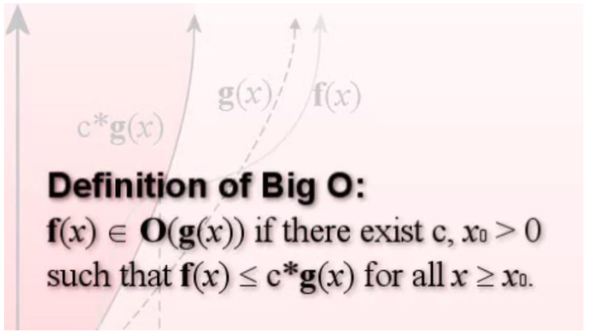
Big oh Notation (O) –Upper bound
It is the formal way to express the upper boundary of an algorithm running time. It measures the worst case of time complexity or the longest amount of time, algorithm takes to complete their operation. It is represented as shown below:

Slide 22
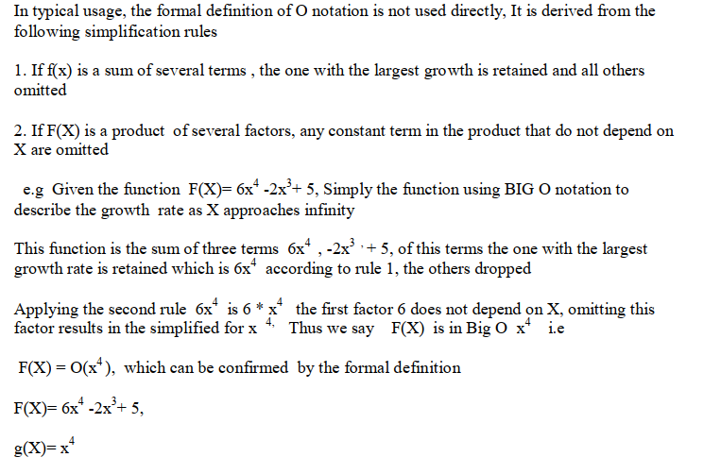
Big O simplification rules

Slide 23
Common Asymptotic Notations(Big O)
constant | O(1) constant time.
linear | O(n) linear time
logarithmic | O(log n)
n log n | O(n log n)
exponential | O(c^n) e.g O(2^n) e.g Fib(n)=Fib(n-1)+Fib(n-2)
cubic | O(n^3)
polynomial | O(n^c)
quadratic | O(n^2) growth directly proportional to the square of the input size
Factorial time | O(n!)
(n = size of input, c = some constant)

Slide 24
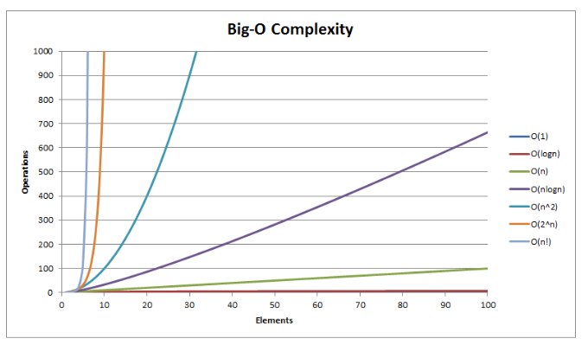
Model graph representing Big-O complexity of some functions

Slide 25
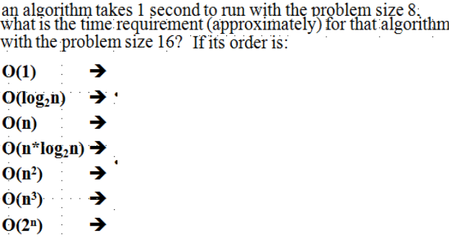
Example

Slide 26
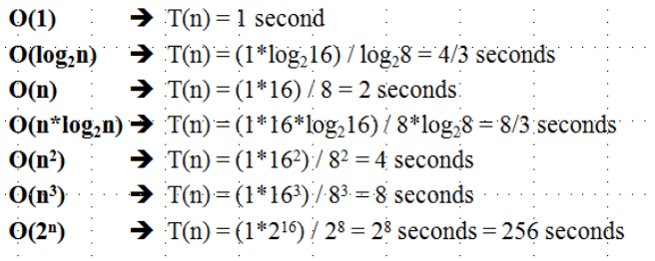
Solution

Slide 27
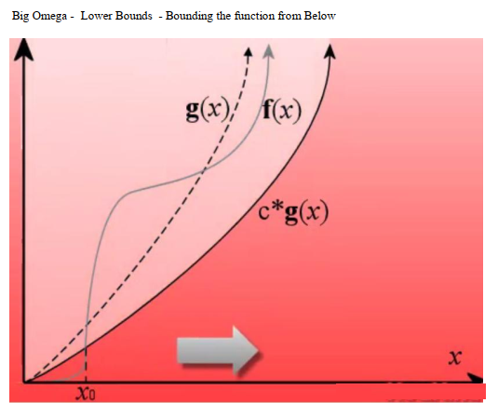
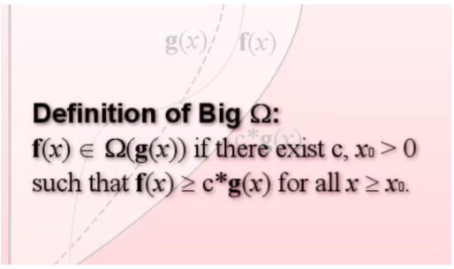
Omega Notation (Ω)
It is the formal way to represent the lower bound of an algorithm's running time. It measures the best amount of time an algorithm can possibly take to complete or the best case time complexity.

Slide 28
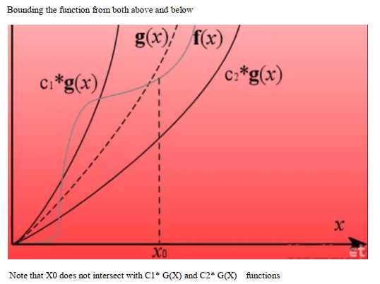
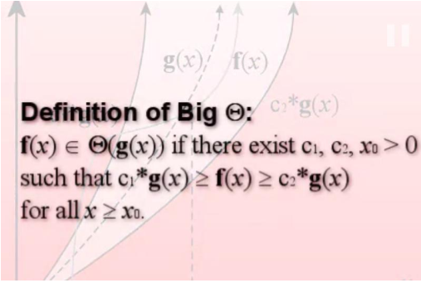
Theta Notation (O)- Tight bound
It is the formal way to express both the upper bound and lower bound of an algorithm running time.

Slide 29
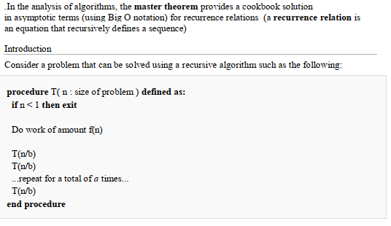
The master theorem

Slide 30


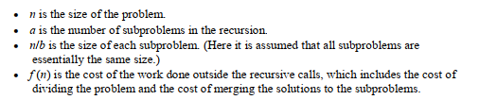

Slide 31
REFERENCE MATERIALS
The design and Analysis of Computer Algorithms by AHO/Hocroft Ullman
Design and analysis of Algorithms by Russell L Shackelford
Introduction to the Design and Analysis of Algorithms by R.C.T Lee, S.S Tseng Chang Y.T Tsai
Judith L GerstingMathematical Structures for computer science 4th edition

